Slide 1
Kaizen for Leaders

Slide 2

Other Modules In This Series:
5S
Standard Work
Total Productive Maintenance (TPM)
Administrative Lean
Cell Design/ Production Preparation Process (3P)
Kaizen
Kanban
Problem Solving
Poka Yoke Quality Systems
Transaction Process Improvement (TPI)
Cause & Effect Diagram with the Additions of Cards (CEDAC)
Single Minute Exchange of Dies (SMED)
Value Stream Mapping (VSMi®)
Visual Management
Managing Daily Process Excellence
For More Information Please Contact:
Mark DeLuzio, President and CEO
+1.860.234.0915
mark.deluzio@leanhorizons.com
Strategically Creating Value Through the Elimination of Waste

Slide 3
This document contains confidential
and proprietary information owned
by Lean Horizons Consulting, LLC.
Any disclosure, use, copying or
distribution of this information without the express written consent of Lean Horizons Consulting is strictly prohibited.

Slide 4
Kaizen for Leaders
Kaizen Overview
Kaizen Planning
Roles & Responsibilities
Successful
Kaizen Events
Sustaining
Results
Objectives:
Define and discuss the importance of kaizen
Review key steps in the kaizen process
Define roles and responsibilities of the key players in kaizen
Review and discuss “leading practices” in executing kaizen
Drive successful kaizen events as leaders in your business
Notes:
DO: Review section objectives on slide.

Slide 5
Kaizen for Leaders
Kaizen Overview
    Overview of Kaizen
Effective Planning of Kaizen Events
Roles and Responsibilities
Conducting Successful Kaizen Events
Sustaining the Results

Slide 6
Kaizen for Leaders
Kaizen Overview
    Overview of Kaizen
Effective Planning of Kaizen Events
Roles and Responsibilities
Conducting Successful Kaizen Events
Sustaining the Results

Slide 7
Kaizen Definition
Kaizen Overview
Points Descriptions
1
改 Kai
Change
2
善 Zen
Good
3
Kaizen
Literally “good change” or “improvement”
A closer definition to the Japanese usage of kaizen is “to take it apart and put back together a better way
What is taken apart is usually a process, system, product, or service

Slide 8
Lean Results from Many Kaizens
Kaizen Overview
The Wiremold Example
 | 1990 | 1995 | 1999
Sales per employee ($000s) | 90 | 190 | 241
Throughput time to produce average product | 4-6 weeks | 1-2 days | 1 day
Product development time | 3 years | 3-6 months | 3 months
Suppliers | 320 | 73 | 73
Inventory turns | 3.4 | 15 | 16
Space required (index) | 100 | 50 | 40
Sales (index) | 100 | 250 | 393
EBITDA $ | 8.2 | 28.8 | 54.7
Gross Margin % | 37.8 | 47.4 | 50.8
Source: Lean Thinking, Womack and Jones
Notes:
For those of you who have read Lean Thinking you may recognize this chart. Wiremold is recognized for its lean transformation. Kaizen has been a part of this very impressive transformation. Note, the time frame to achieve the sustained performance. A lot of improvement was realized in the first few years. Wiremold continues on the lean journey.

Slide 9
The Kaizen Process: The Plan, Do, Check, Act Cycle
Kaizen Overview
PLAN
Identify Waste, normal vs. abnormal
Plan Countermeasures
Reality Check
DO
Make Change
ACT
Make this the new
standard
Celebrate
Do it again!
Document reality
CHECK
Verify Change
Quantify Results

Slide 10
Kaizen for Leaders
Kaizen Planning
    Overview of Kaizen
Effective Planning of Kaizen Events
Roles and Responsibilities
Conducting Successful Kaizen Events
Sustaining the Results

Slide 11
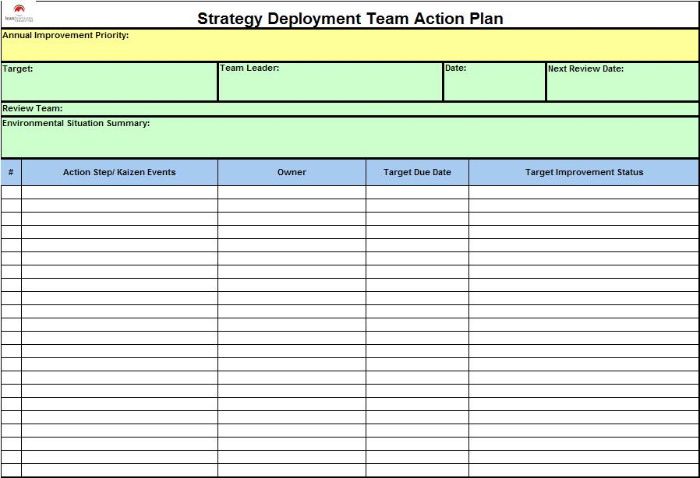
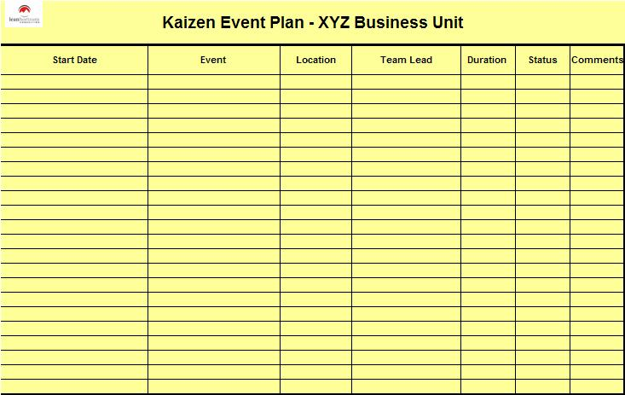
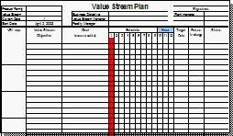
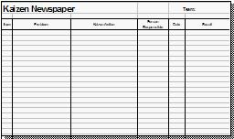
Selecting and Planning Kaizen Events
Kaizen Planning
Strategy
Deployment
Action Plan
Kaizen Event Plan
Value
Stream
Plan
Review
Prioritize
Schedule
Kaizen
Newspaper
Avoid Drive-by Kaizen!
“Don’t shoot everything that moves” (with kaizen)
Notes:
Explain that randomly selected, unconnected kaizen events, while yielding improvement, are not likely to achieve the overall goals of the company in a reasonable timeframe.
“Don’t shoot everything that moves” (with kaizen)
Avoid measuring solely by the “numbers” (e.g. # of events conducted by department, # of events attended by individual)

Slide 12
Scoping a Kaizen Event
Kaizen Planning
Kaizen is small incremental change
  Don’t try to “eat the elephant” in one bite
  Strive for more small and successful events
Should be accomplished within a week
  If not, plan several events
  Improvements should be made during the event, not just planned
  Should not prevent stretch goals from being set
  Kaizen teams need to “win”
Be careful about declaring “Monuments”
  Things or areas declared as “off-limits” to the kaizen team
  Too many Monuments = paralysis and suboptimal change
  Teams need to be empowered to make (not recommend) change

Slide 13
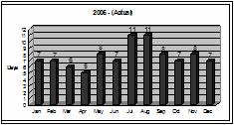
Typical Kaizen Event Charter
Kaizen Planning
Business Case /Strategic Alignment
Opportunity
1-3 sentences why this event is being chartered.
Link to SD Action Plan, VSM or other business goal
Current Data
(e.g. Run Chart)
Target
Scope
In
Out
Scope
Reduce <clearly-defined metric> by xx% (from $xxM to $.xM) by MM/DD/YY. Tie to “Opportunity” data
xxx
xxx
xxx
xxx
yyy
yyy
yyy
yyy
Deliverables
List specific deliverables from the kaizen
Team
<name> Team Leader
<name> Facilitator (Sensei)
<name> <department/function>
<name> <department/function>
<name> <department/function>
<name> <department/function>
<name> <department/function>
Schedule
mm/dd/yy to mm/dd/yy

Slide 14
The Kaizen Event Charter – Common Pitfalls
Kaizen Planning
Scope is too large or vague
Problem/opportunity not well-defined – no supporting data
Target goals not set or are vague – unclear metrics
  Be precise and complete – no ambiguity
  Use existing supporting data to help articulate the goal
  Time-fence the expectation (by when?)
  Use metrics that can be supported and tracked post-event
    e.g. “Reduce the # of machining defects in cell XYZ from 50% to <5% by MM/DD/YY”
No formal review/approval of charter prior to sanctioning event
Not completed far enough in advance of event
Notes:
Scope is too large or vague
Re-size or schedule multiple events if necessary
Problem/opportunity not well-defined – no supporting data
Define the goal clearly in 1-2 sentences, provide supporting data
Target goals not set or are vague – unclear metrics
Be precise and complete – no ambiguity
Use existing supporting data to help articulate the goal
Time-fence the expectation (by when?)
Use metrics that can be supported and tracked post-event
e.g. “Reduce the # of machining defects in cell XYZ from 50% to <5% by MM/DD/YY”
No formal review/approval of charter
Review and approve each charter prior to sanctioning the event
Not completed far enough in advance of event
Complete and approve at least two weeks prior to the start of the event

Slide 15
Kaizen for Leaders
Roles and Responsibilities
    Overview of Kaizen
Effective Planning of Kaizen Events
Roles and Responsibilities
Conducting Successful Kaizen Events
Sustaining the Results

Slide 16
Team Leader Roles and Responsibilities
Roles and Responsibilities
Team Leader
Select team members and identify SMEs
Draft charter and get approved
Set scope and expectations
Define target metrics and timeframe
Lead discussions and activities throughout the event
“Own” the kaizen newspaper – make sure every action item is completed

Slide 17
Team Member Roles and Responsibilities
Roles and Responsibilities
Team Leader
Actively participate in the event
Contribute knowledge and insight
Produce deliverables as required
Take responsibility for specific action items on the Kaizen newspaper
Team Member

Slide 18
Subject Matter Expert Roles and Responsibilities
Roles and Responsibilities
Team Leader
Collaborate with Team Leader during event planning
Be available (on call) during the event to provide point expertise
Gather data and render information as needed to support the event
Review team decisions and deliverables if/when asked
Team Member
Subject Matter Expert

Slide 19
Facilitator/Sensei Roles and Responsibilities
Roles and Responsibilities
Team Leader
Provide training
Contribute knowledge and experience
Consult and guide team in application of lean principles, methods and tools
Work closely with (coach) the Team Leader to help him/her lead a successful event
Drive and stretch the team into thinking and acting “outside the box”
Facilitate to assure results are achieved and the process is followed
Team Member
Subject Matter Expert
Facilitator/Sensei

Slide 20
Process Owner Roles and Responsibilities
Roles and Responsibilities
Team Leader
May serve as a Team Leader or Team Member
Provide deep expertise about the process
Assist in formulating the charter
Be responsible for realizing and sustaining results within the process
Team Member
Subject Matter Expert
Facilitator/Sensei
Process Owner

Slide 21
Executive Sponsor Roles and Responsibilities
Roles and Responsibilities
Team Leader
Sanction events
Provide funding and resources as needed
Empower the teams to effect change
Provide visible support throughout the process
Attend team leader meetings and event report outs
Team Member
Subject Matter Expert
Facilitator/Sensei
Process Owner
Executive Sponsor

Slide 22
Kaizen for Leaders
Successful Kaizen Events
    Overview of Kaizen
Effective Planning of Kaizen Events
Roles and Responsibilities
Conducting Successful Kaizen Events
Sustaining the Results

Slide 23
Key Factors for Successful Kaizen
Successful Kaizen Events
Follow a prescribed kaizen methodology
Plan events well ahead of their execution
  Approve charter at least two weeks prior
  Identify / contact team leads and participants to clarify roles
  Use an experienced facilitator/sensei (lean coordinator or consultant)
Empower teams to make change, not ask permission
Management attention and involvement
  Review event plans and charters
  Attend team leader meetings and event report-outs
  Recognize and reward team accomplishments
Follow-up and assure sustained results – track metrics formally
Notes:
Be approachable and responsive if teams need help

Slide 24
Kaizen for Leaders
Sustaining Results
    Overview of Kaizen
Effective Planning of Kaizen Events
Roles and Responsibilities
Conducting Successful Kaizen Events
Sustaining the Results

Slide 25
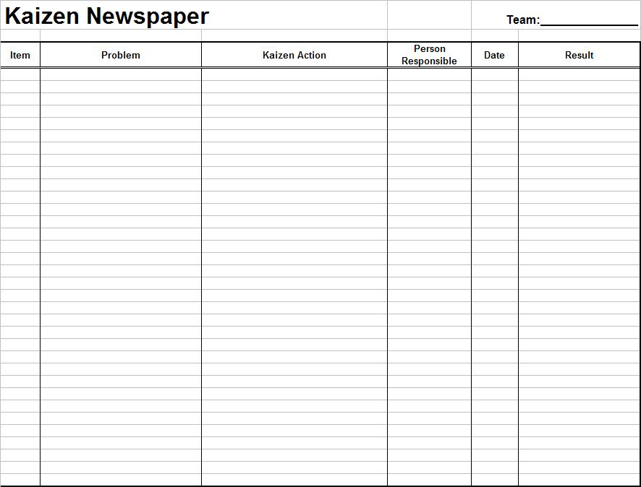
Kaizen Newspaper
Sustaining Results
Used to Track Future Kaizen Progress and
Value Stream Implementation Steps
Notes:
Explain how to use the kaizen newspaper
What kind of things go on it?
“Person responsible” should always be someone on the team – responsible for getting it done, themselves or through others (no passing the buck)
Team Leader has overall responsibility to see that every item on the newspaper is completed
Helpful Suggestions:
- Better to get it done during the event than to put it on the newspaper
- Avoid “planning-only” Kaizens that are 100% plans to improve but no changes actually made
Describe the tracking process

Slide 26
Sustaining the Results
Sustaining Results
Make sure responsibilities are clearly communicated
  Team Leader – overall kaizen newspaper
  Team members – individual newspaper items
  Process owners and operators – executing resulting Standard Work
Keep the Kaizen Newspaper visible
  Physical or electronic posting – updated regularly until closed out
  Visible Metrics Board with planned / actual run charts
  Offer and provide leadership help where needed
Hold periodic reviews of recent Kaizen events and results
  Ensure that improvements become Standard Work
  Keep management attention high – communicate through action
  Recognize teams for their accomplishments

Slide 27
Institutionalize Kaizen
Sustaining Results
“End Game” is to make kaizen and continuous improvement an integral part of day-to-day operation
Move from fewer formal, structured events to many smaller incremental change improvements
Total involvement of everyone in the workforce at all levels
Deep seeded in the company culture
A relentless and never-ending pursuit of excellence
“Events” “Way of Life”

Slide 28
Exercise: Action Plan and Personal Plan Development
Sustaining Results
Objective
Apply learnings from Kaizen for Leaders to your Action Plan and/or Personal Plan
Instructions
Time to Complete
Ideas to consider for your Action Plan and your Personal Plan:
Do you have a formal and well-structured kaizen process in place?
Is it being followed?
Is your event plan tied to strategic objectives?
Are events properly chartered and reviewed in advance?
Are team roles and responsibilities well understood and communicated?
Is there a post-event process in place to measure and sustain results?
Deliverable
Report out on plans
Notes:
NOTE: With completed matrix, instruct class on how this information would be transferred to a Bowling Chart, and how the information would be reviewed monthly – if off plan, discuss the use of countermeasures to get back on track.

Slide 29
Other Modules In This Series:
5S
Standard Work
Total Productive Maintenance (TPM)
Administrative Lean
Cell Design/ Production Preparation Process (3P)
Kaizen
Kanban
Problem Solving
Poka Yoke Quality Systems
Transaction Process Improvement (TPI)
Cause & Effect Diagram with the Additions of Cards (CEDAC)
Single Minute Exchange of Dies (SMED)
Value Stream Mapping (VSMi®)
Visual Management
Managing Daily Process Excellence
For More Information Please Contact:
Mark DeLuzio, President and CEO
+1.860.234.0915
mark.deluzio@leanhorizons.com
Strategically Creating Value Through the Elimination of Waste

